Slide 1
Exploratory Data Analysis and Data Visualization
Credits: ChrisVolinsky - Columbia University

Slide 2
Outline
EDA
Visualization
  One variable
  Two variables
  More than two variables
  Other types of data
  Dimension reduction

Slide 3
EDA and Visualization
Exploratory Data Analysis (EDA) and Visualization are very important steps in any analysis task.
get to know your data!
  distributions (symmetric, normal, skewed)
  data quality problems
  outliers
  correlations and inter-relationships
  subsets of interest
  suggest functional relationships
Sometimes EDA or viz might be the goal!

Slide 4
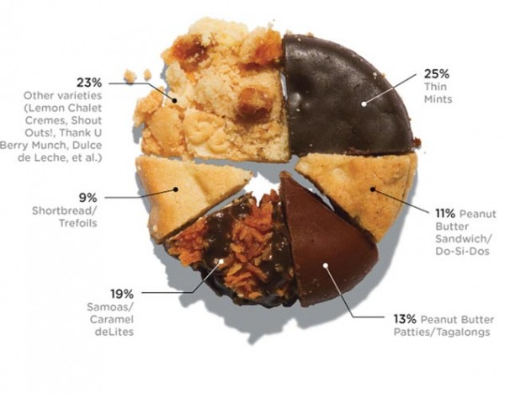
Data Visualization – cake bakery

Slide 5

Exploratory Data Analysis (EDA)
Goal: get a general sense of the data
  means, medians, quantiles, histograms, boxplots
  You should always look at every variable - you will learn something!
data-driven (model-free)
Think interactive and visual
  Humans are the best pattern recognizers
  You can use more than 2 dimensions!
    x,y,z, space, color, time….
Especially useful in early stages of data mining
  detect outliers (e.g. assess data quality)
  test assumptions (e.g. normal distributions or skewed?)
  identify useful raw data & transforms (e.g. log(x))
Bottom line: it is always well worth looking at your data!

Slide 6
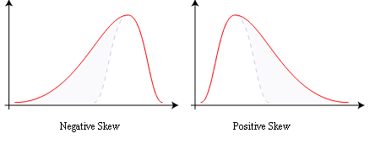
Summary Statistics
not visual
sample statistics of data X
  mean: μ = ∑_{i} X_{i} / n
  mode: most common value in X
  median: X=sort(X), median = X_{n/2} (half below, half above)
  quartiles of sorted X: Q1 value = X_{0.25n} , Q3 value = X_{0.75 n}
    interquartile range: value(Q3) - value(Q1)
    range: max(X) - min(X) = X_{n} - X₁
  variance: σ² = ∑_{i} (X_{i} - μ)² / n
  skewness: ∑_{i} (X_{i} - μ)³ / [ (∑_{i} (X_{i} - μ)²)^{3/2} ]
    zero if symmetric; right-skewed more common (what kind of data is right skewed?)
  number of distinct values for a variable (see unique() in R)
  Don’t need to report all of thses: Bottom line…do these numbers make sense???

Slide 7
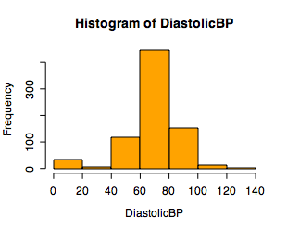
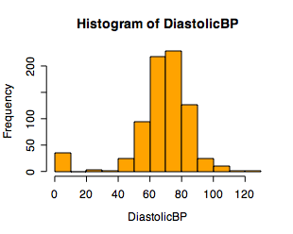
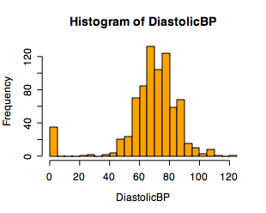
Single Variable Visualization
Histogram:
  Shows center, variability, skewness, modality,
  outliers, or strange patterns.
  Bin width and position matter
  Beware of real zeros

Slide 8
Issues with Histograms
For small data sets, histograms can be misleading.
  Small changes in the data, bins, or anchor can deceive
For large data sets, histograms can be quite effective at illustrating general properties of the distribution.
Histograms effectively only work with 1 variable at a time
  But ‘small multiples’ can be effective

Slide 9
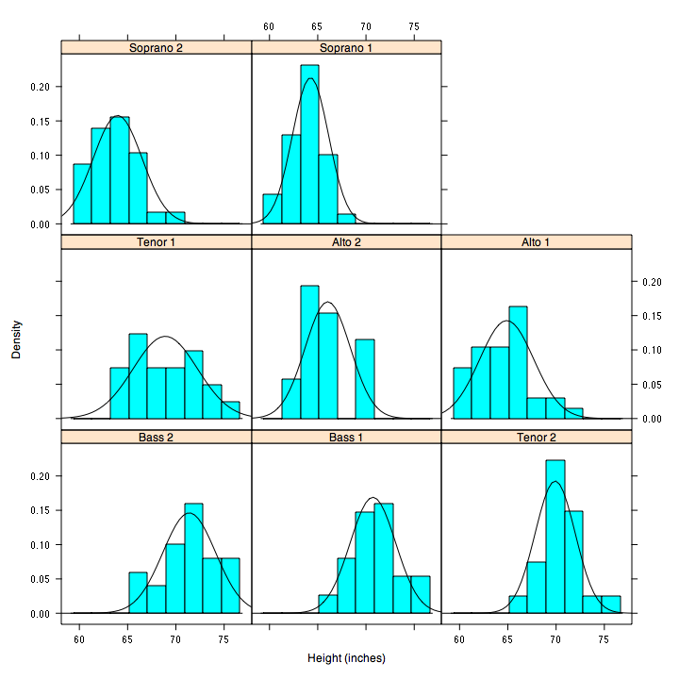
But be careful with axes and scales!

Slide 10
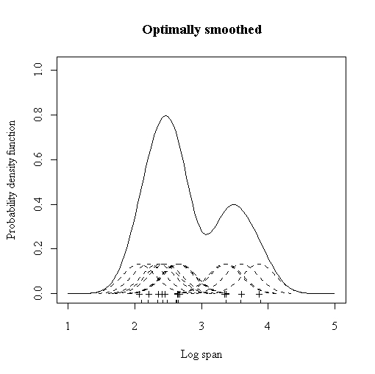
Smoothed Histograms - Density Estimates
Kernel estimates smooth out the contribution of each datapoint over a local neighborhood of that point.
h is the kernel width
Gaussian kernel is common:

Slide 11
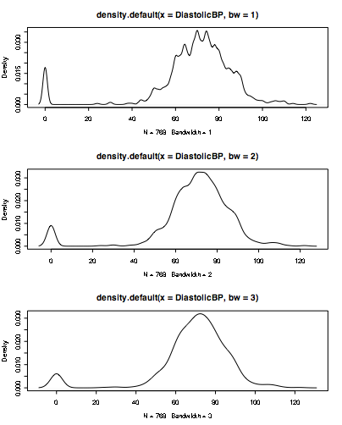
Bandwidth choice is an art
Usually want to try several

Slide 12
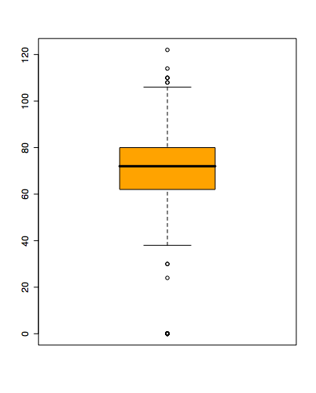
Boxplots
Shows a lot of information about a variable in one plot
  Median
  IQR
  Outliers
  Range
  Skewness
Negatives
  Overplotting
  Hard to tell distributional shape
  no standard implementation in software (many options for whiskers, outliers)
Notes:
Horizontal line in box is median (Q2)
Top and bottom of plot are always Q1 and Q3
Whiskers can mean several things: usually these are the minimum and maximum of all of the data
Values outside this range are pkptted as outliers (circles)

Slide 13
Time Series
If your data has a temporal component, be sure to exploit it
summer bifurcations in air travel
(favor early/late)
summer
peaks
steady growth
trend
New Year bumps

Slide 14
Time-Series Example 3
mean weight vs mean age
for 10k control group
Scotland experiment:
“↑ milk in kid diet → better health” ?
20,000 kids:
5k raw, 5k pasteurize,
10k control (no supplement)
Possible explanations:
Grow less early in year than later?
No steps in height plots; so why
height ↑ uniformly, weight ↑ spurts?
Kids weighed in clothes: summer garb lighter than winter?
Would expect smooth weight growth plot.
Visually reveals
unexpected pattern (steps),
not apparent from raw data table.

Slide 15
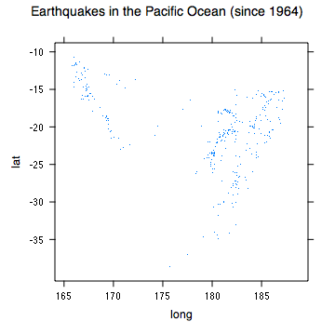
Spatial Data
If your data has a geographic component, be sure to exploit it
Data from cities/states/zip cods – easy to get lat/long
Can plot as scatterplot

Slide 16
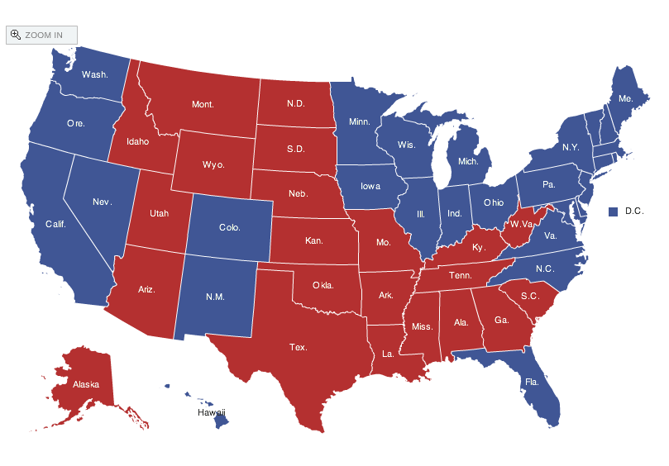
Spatial data: choropleth Maps
Maps using color shadings to represent numerical values are called chloropleth maps
http://elections.nytimes.com/2008/results/president/map.html

Slide 17
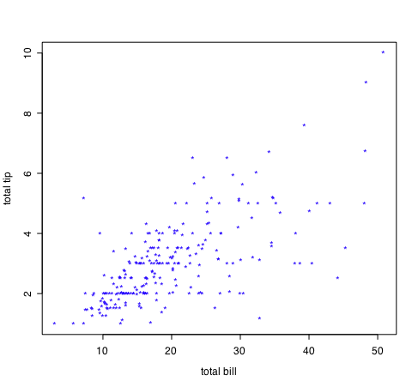
Two Continuous Variables
For two numeric variables, the scatterplot is the obvious choice
interesting?
interesting?

Slide 18
2D Scatterplots
standard tool to display relation between 2 variables
  e.g. y-axis = response, x-axis = suspected indicator
useful to answer:
  x,y related?
    linear
    quadratic
    other
  variance(y) depend on x?
  outliers present?
interesting?
interesting?

Slide 19
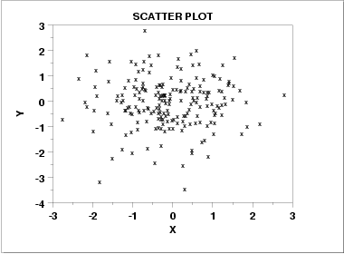
Scatter Plot: No apparent relationship

Slide 20
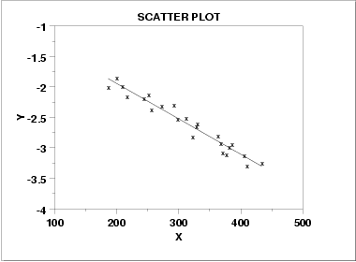
Scatter Plot: Linear relationship

Slide 21
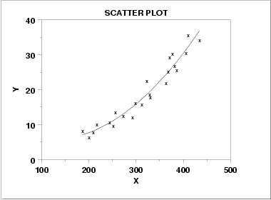
Scatter Plot: Quadratic relationship

Slide 22
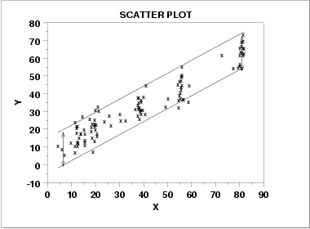
Scatter plot: Homoscedastic
Why is this important in classical statistical modelling?

Slide 23
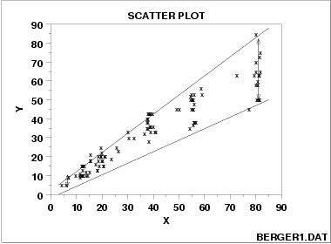
Scatter plot: Heteroscedastic
variation in Y differs depending on the value of X
e.g., Y = annual tax paid, X = income

Slide 24
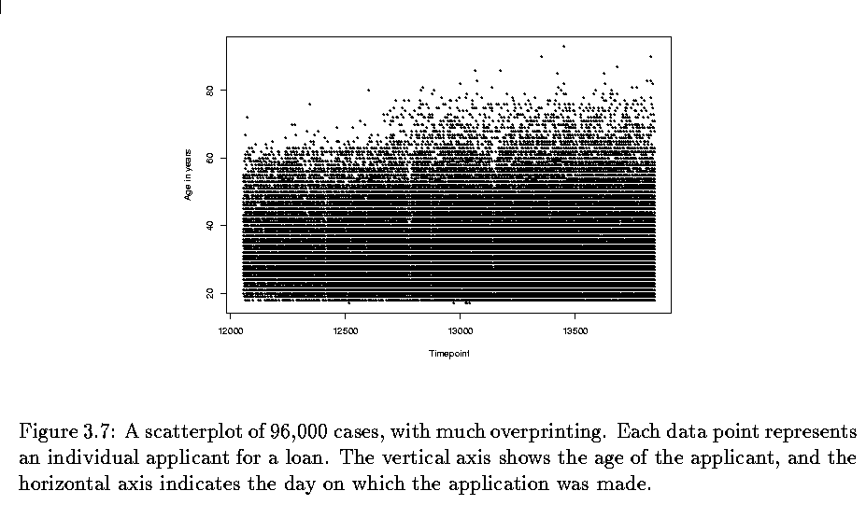
Two variables - continuous
Scatterplots
  But can be bad with lots of data

Slide 25
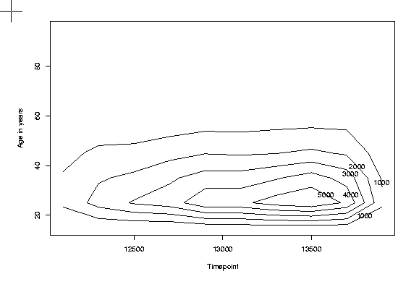
Two variables - continuous
What to do for large data sets
  Contour plots

Slide 26
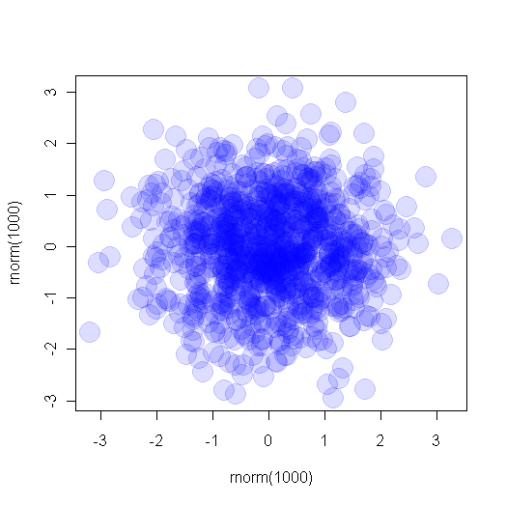
Transparent plotting
Alpha-blending:
plot( rnorm(1000), rnorm(1000), col="#0000ff22", pch=16,cex=3)

Slide 27
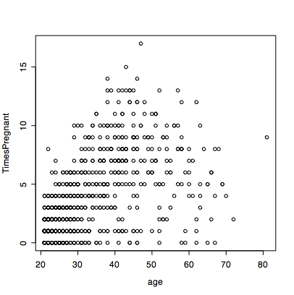
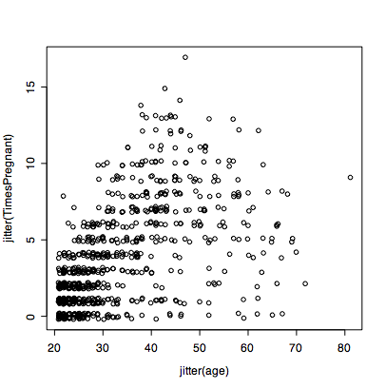
Jittering
Jittering points helps too
plot(age, TimesPregnant)
plot(jitter(age),jitter(TimesPregnant)

Slide 28
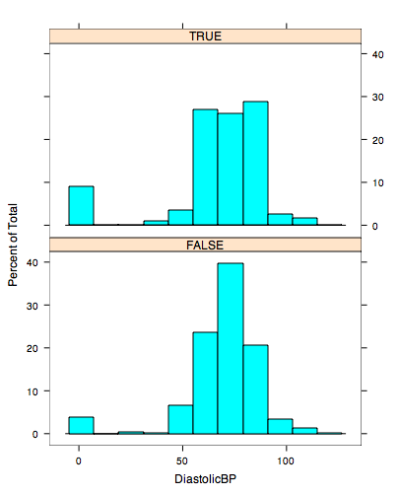
Displaying Two Variables
If one variable is categorical, use small multiples
Many software packages have this implemented as ‘lattice’ or ‘trellis’ packages
library(‘lattice’)
histogram(~DiastolicBP | TimesPregnant==0)

Slide 29
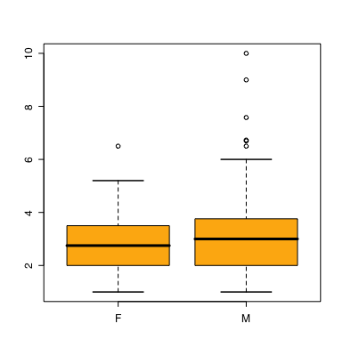
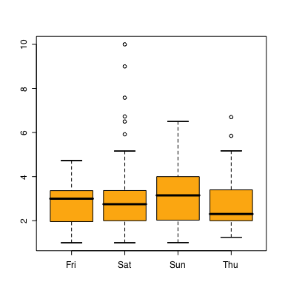
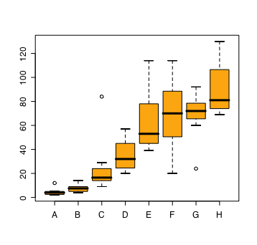
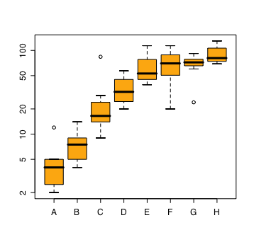
Two Variables - one categorical
Side by side boxplots are very effective in showing differences in a quantitative variable across factor levels
  tips data
    do men or women tip better
  orchard sprays
    measuring potency of various orchard sprays in repelling honeybees

Slide 30
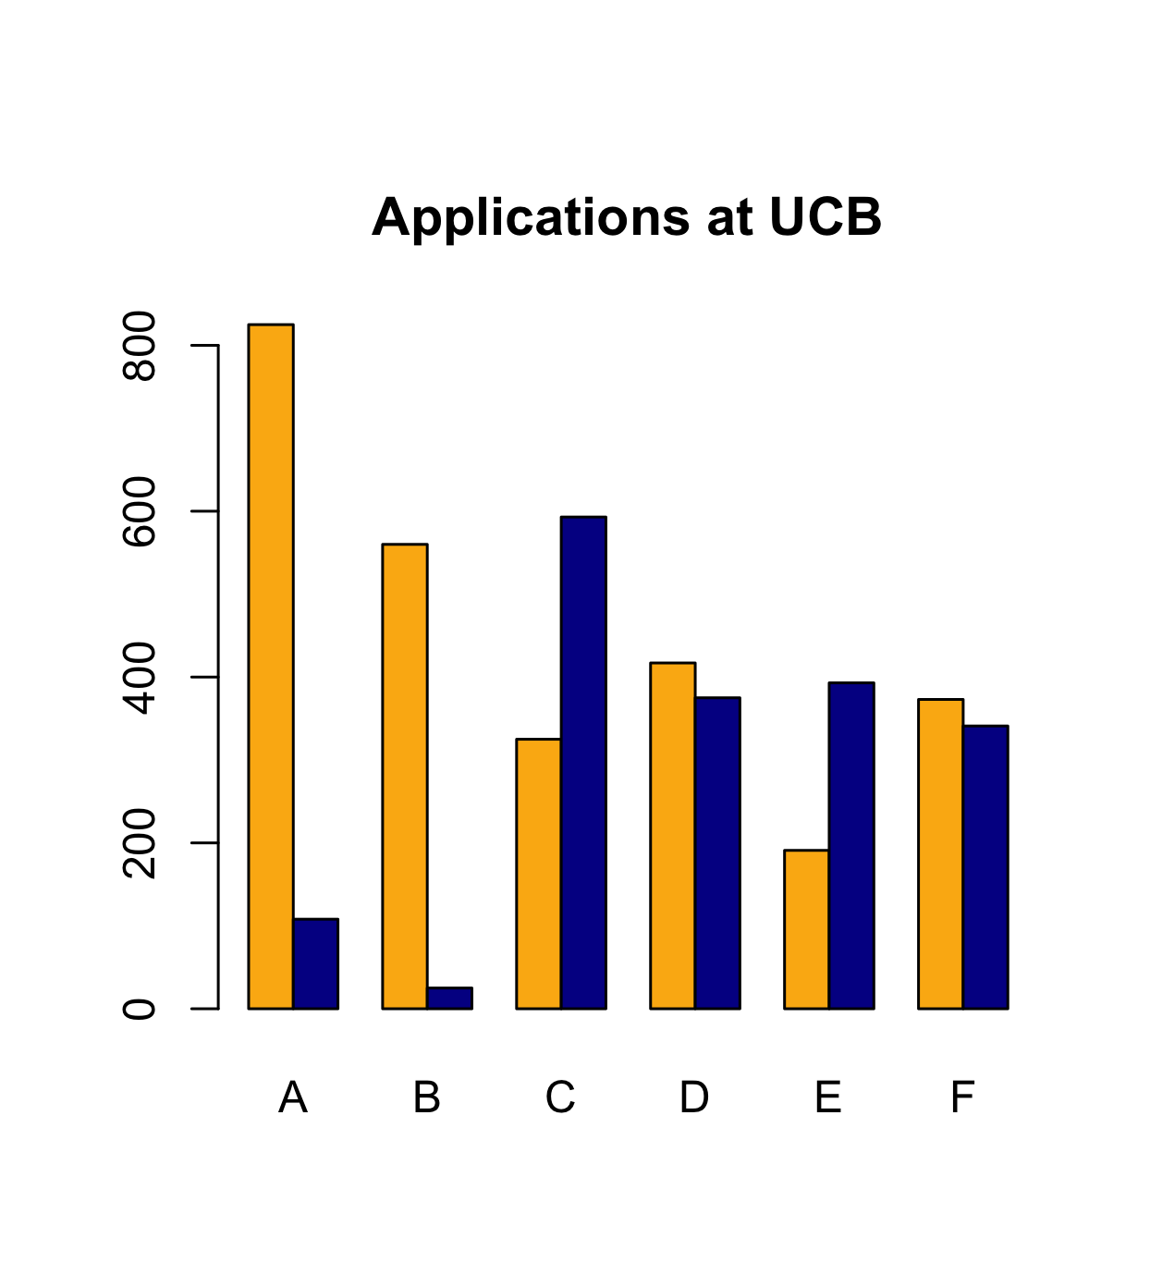
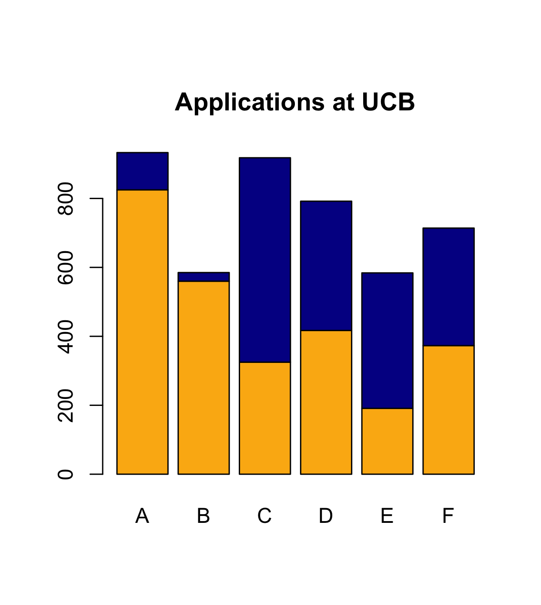
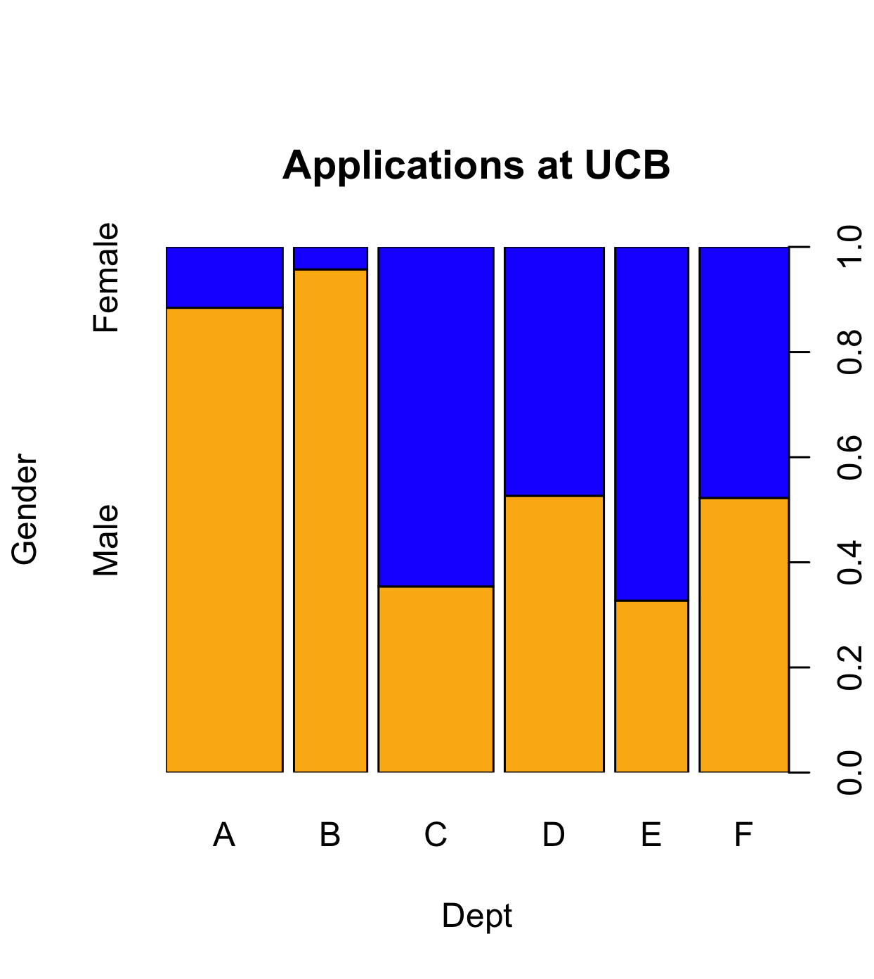
Barcharts and Spineplots
stacked barcharts can be used to compare continuous values across two or more categorical ones.
spineplots show proportions well, but can be hard to interpret
orange=M blue=F

Slide 31
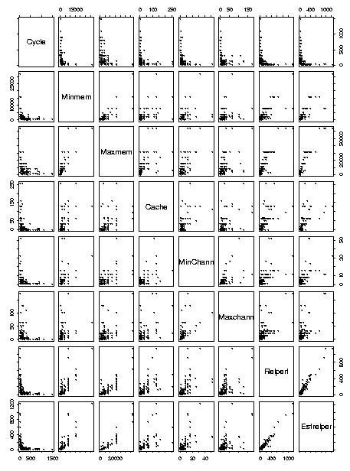
More than two variables
Pairwise scatterplots
Can be somewhat ineffective for categorical data

Slide 32
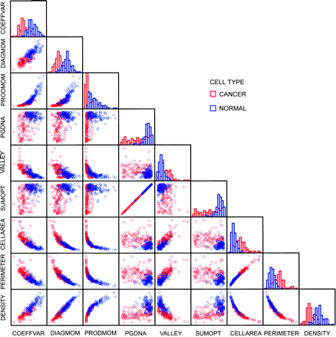

Slide 33
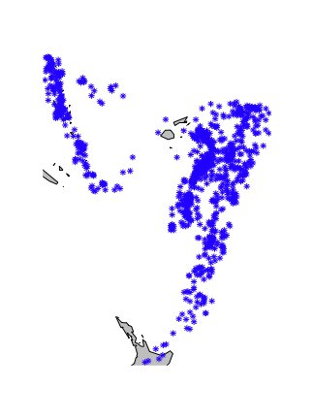
Multivariate: More than two variables
Get creative!
Conditioning on variables
  trellis or lattice plots
  Cleveland models on human perception, all based on conditioning
  Infinite possibilities
Earthquake data:
  locations of 1000 seismic events of MB > 4.0. The events occurred in a cube near Fiji since 1964
  Data collected on the severity of the earthquake

Slide 34
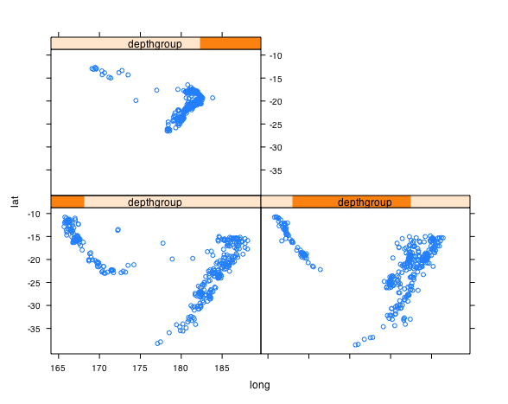

Slide 35
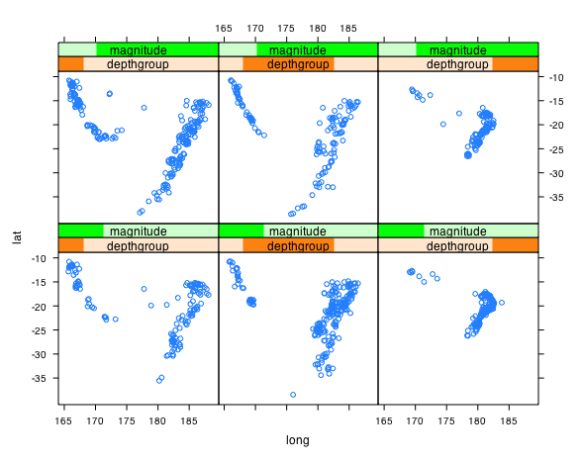

Slide 36
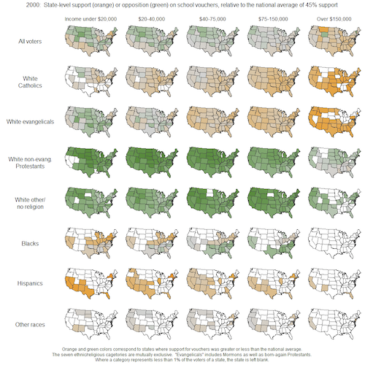
How many dimensions are represented here?
Andrew Gelman blog 7/15/2009

Slide 37

Multivariate Vis: Parallel Coordinates
Petal, a non-reproductive part of the flower
Sepal, a non-reproductive part of the flower
The famous iris data!
Notes:
עלי כותרת (petals) ועלי גביע )sepals)

Slide 38
Parallel Coordinates
Sepal
Length
5.1

Slide 39
Parallel Coordinates: 2 D
Sepal
Length
Sepal
Width
3.5
5.1

Slide 40
Parallel Coordinates: 4 D
Sepal
Length
Sepal
Width
Petal
length
Petal
Width
3.5
5.1
0.2
1.4

Slide 41
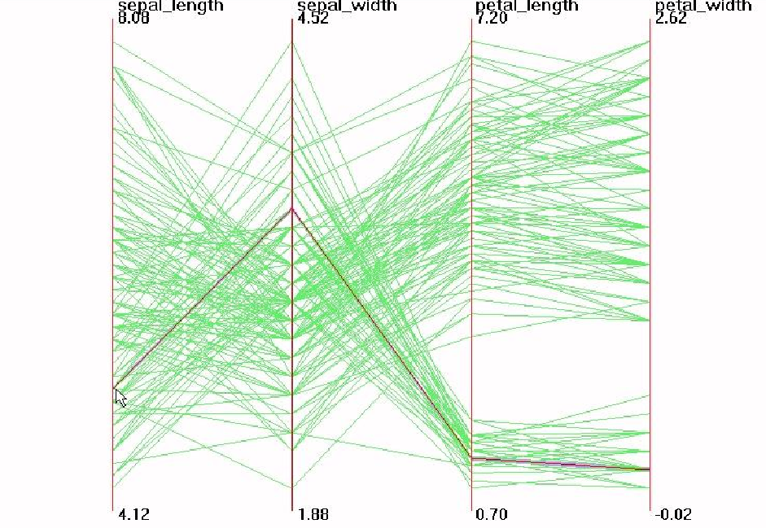
Parallel Visualization of Iris data
3.5
5.1
1.4
0.2

Slide 42
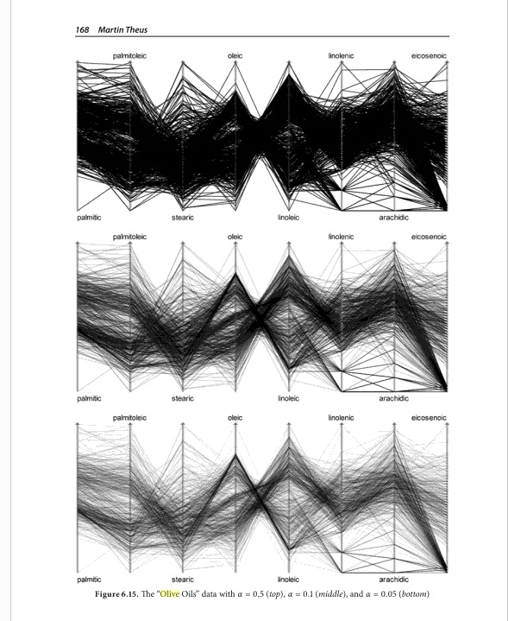
Multivariate: Parallel coordinates
Alpha blending can be effective
Courtesy Unwin, Theus, Hofmann

Slide 43
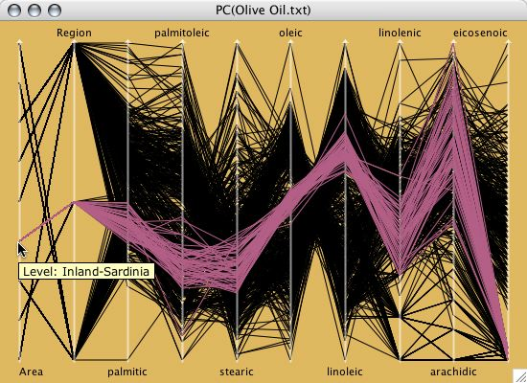
Parallel coordinates
Useful in an interactive setting

Slide 44
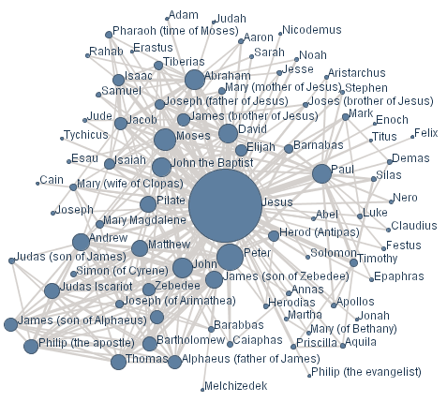
Networks and Graphs
Visualizing networks is helpful, even if is not obvious that a network exists

Slide 45
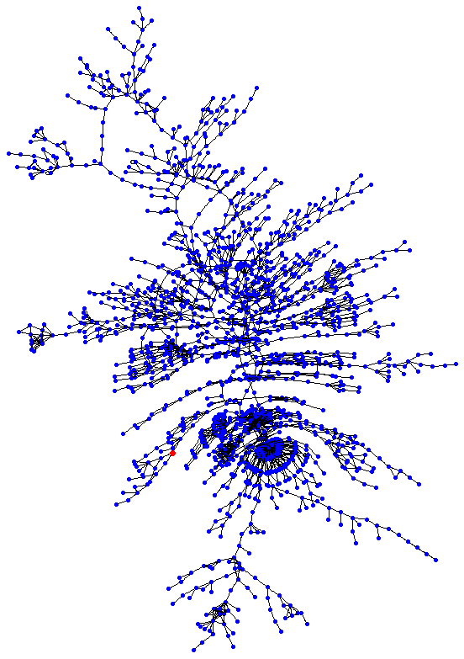
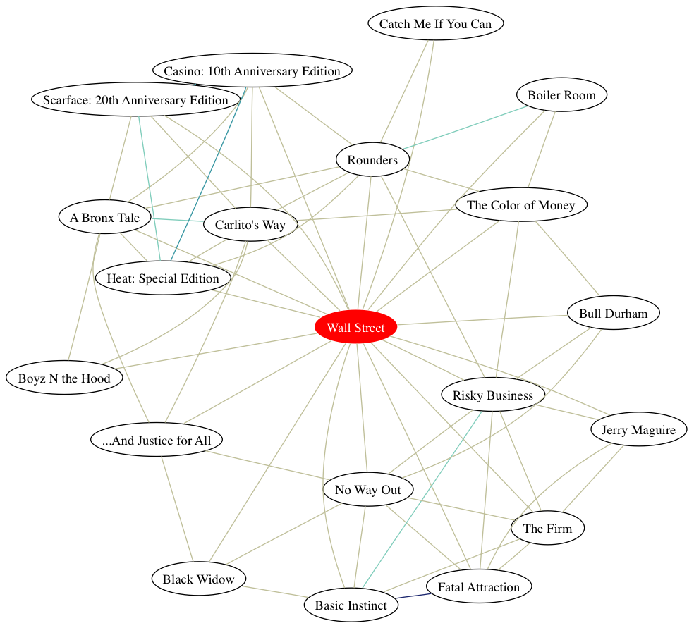
Network Visualization
Graphviz (open source software) is a nice layout tool for big and small graphs

Slide 46
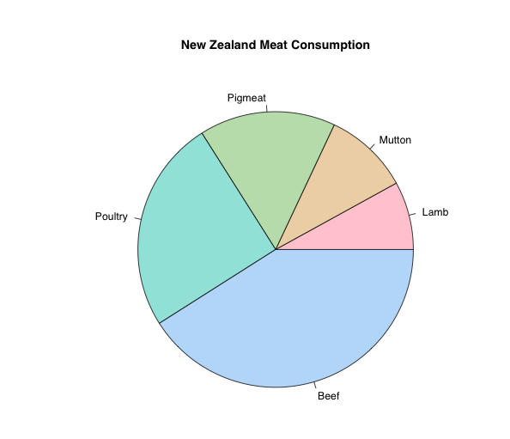
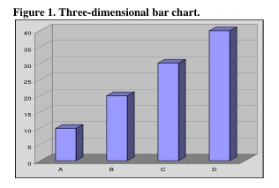
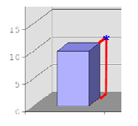
What’s missing?
pie charts
  very popular
  good for showing simple relations of proportions
  Human perception not good at comparing arcs
  barplots, histograms usually better (but less pretty)
3D
  nice to be able to show three dimensions
  hard to do well
  often done poorly
  3d best shown through “spinning” in 2D
    uses various types of projecting into 2D
    http://www.stat.tamu.edu/~west/bradley/

Slide 47
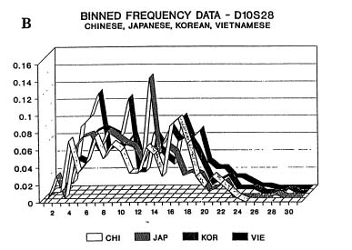
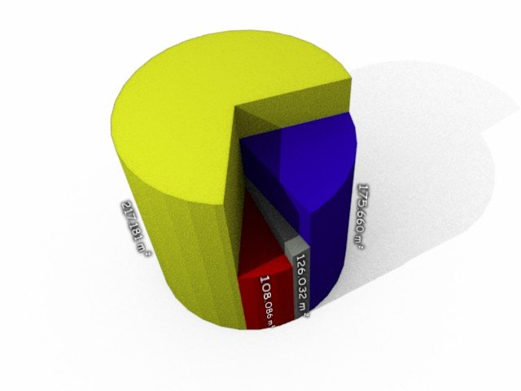
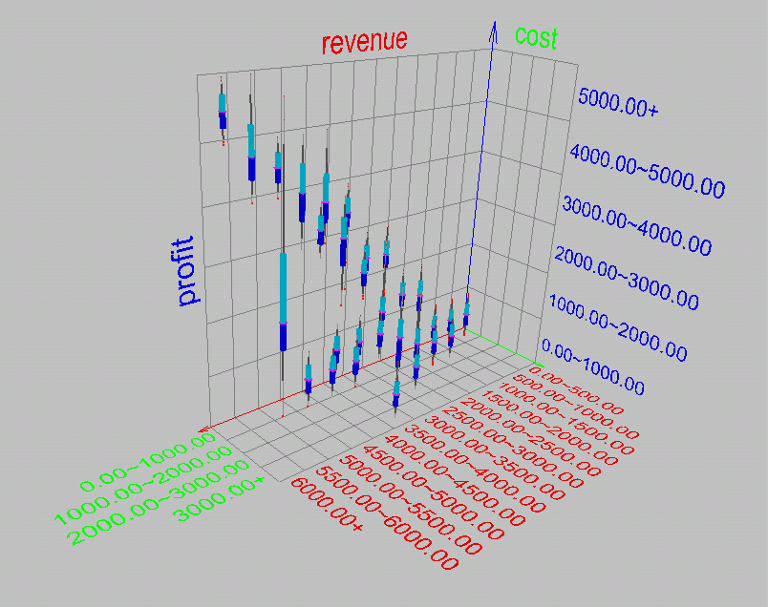
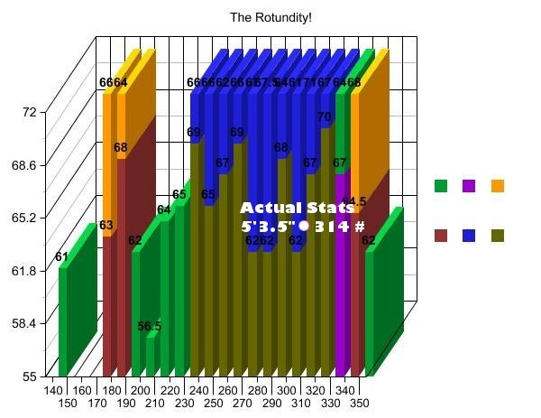
Worst graphic in the world?

Slide 48
Dimension Reduction
One way to visualize high dimensional data is to reduce it to 2 or 3 dimensions
  Variable selection
    e.g. stepwise
  Principle Components
    find linear projection onto p-space with maximal variance
  Multi-dimensional scaling
    takes a matrix of (dis)similarities and embeds the points in p-dimensional space to retain those similarities
More on this in next Topic

Slide 49
Visualization done right
Hans Rosling @ TED
http://www.youtube.com/watch?v=jbkSRLYSojo

